Slide 1
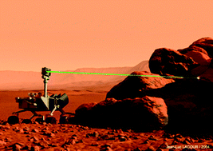
Adaptive Exploration for Geological Classification
Team:
Aishanou Osha Rait
Shivam Gautam
Tushar Agrawal
Bishwamoy Sinha Roy

Slide 2
Overview
Problem Introduction
Simulation Environment
Aspect 1 – Where to sample
Aspect 2 – How to get to sampling point
Results
Conclusion

Slide 3
Problem Introduction
Rover exploration of extra-terrestrial bodies is slow
One of the motives of exploration – Rock classification
Spectrometer readings to classify rocks

Slide 4
Problem Introduction
Satellite Spectrometers have low wavelength and spatial resolution and high sensor noise
Ground based spectrometer sampling is costly
Optimization Problem
Where to sample such that the rock classification has lowest uncertainty.

Slide 5
Problem Introduction
Select Sampling Point
Sample the point
Plan path to sample point
Update spectrometer data
Two main challenges:
Where to sample
How to get there

Slide 6
Simulation Environment
Provides three pieces of information
Information 1 – Satellite Reading for a region
Containing less number of channel
Information 2 – Rover reading at each point in the region
Result of sampling a point – more number of channels (higher resolution)
Information 3 – True classification of each point
We control
Noise in sensor
Number of classes
Number of dominant and rare classes

Slide 7
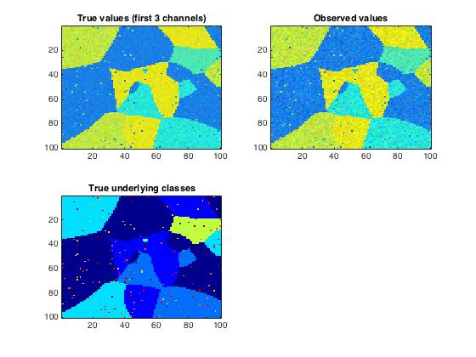
Simulation Environment

Slide 8
Aspect 1: Where to sample
Method 1: Variance based Entropy

Slide 9
Aspect 1: Where to sample
Method 1: Feature Space based Entropy

Slide 10
General Flow
Satellite Data in feature space
Cluster
Probabilities and entropy calculation
Maximum entropy point sample
Replace sampled point with data

Slide 11
General Flow cont.
Define vector of movement of sampled point
Gaussian around moved point to move near-by points
Update feature space

Slide 12
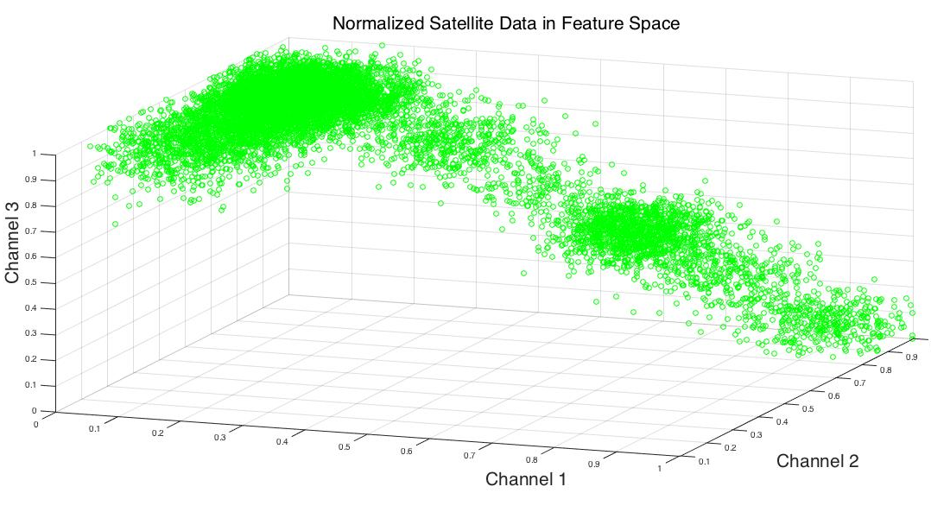
Data in Feature Space

Slide 13
Clustering
K-means
Parametric approach – assumes number of classes (not available)
Mean-shift
Non-parametric approach – bandwidth keeps changing
Optimization parameter – people have done this...
might not capture the rare classes as they are sparse
Meanshift (0.2)
Kmeans

Slide 14
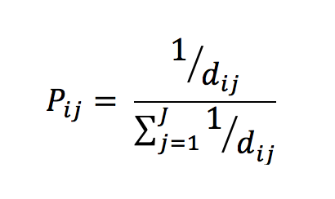
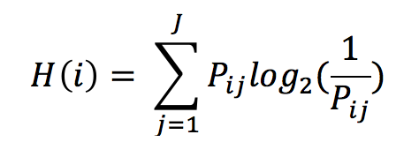
Probability and Entropy
i = feature point j = cluster J = total number of clusters
Shannon’s Entropy for each feature point Units – bits (log base 2)

Slide 15
Re-sampling
Gaussian around sampled point
sigma proportional to distance to closes cluster center

Slide 16
Results
2.96% decrease
1.25% decrease
Overall average entropy decrease in both methods..

Slide 17
Aspect 2: How to get to point
Method 1: Multi-Heuristic A*

Slide 18
Aspect 2: How to get to point
Method 1: DP path length constraint planning

